Slide 1
ISMART

Slide 2
R2 Phases

Slide 3
Delivery
New Business Funnel
Performance Tracking Teaming (Day 1, Day 2)
Customer Portfolio (Day 1) Career Benefit
AAD + SSO Integration
Home Screen Redesign (Day 1) Enhanced Policy View (Day 1) Secretary Access (Day 1)

Slide 4
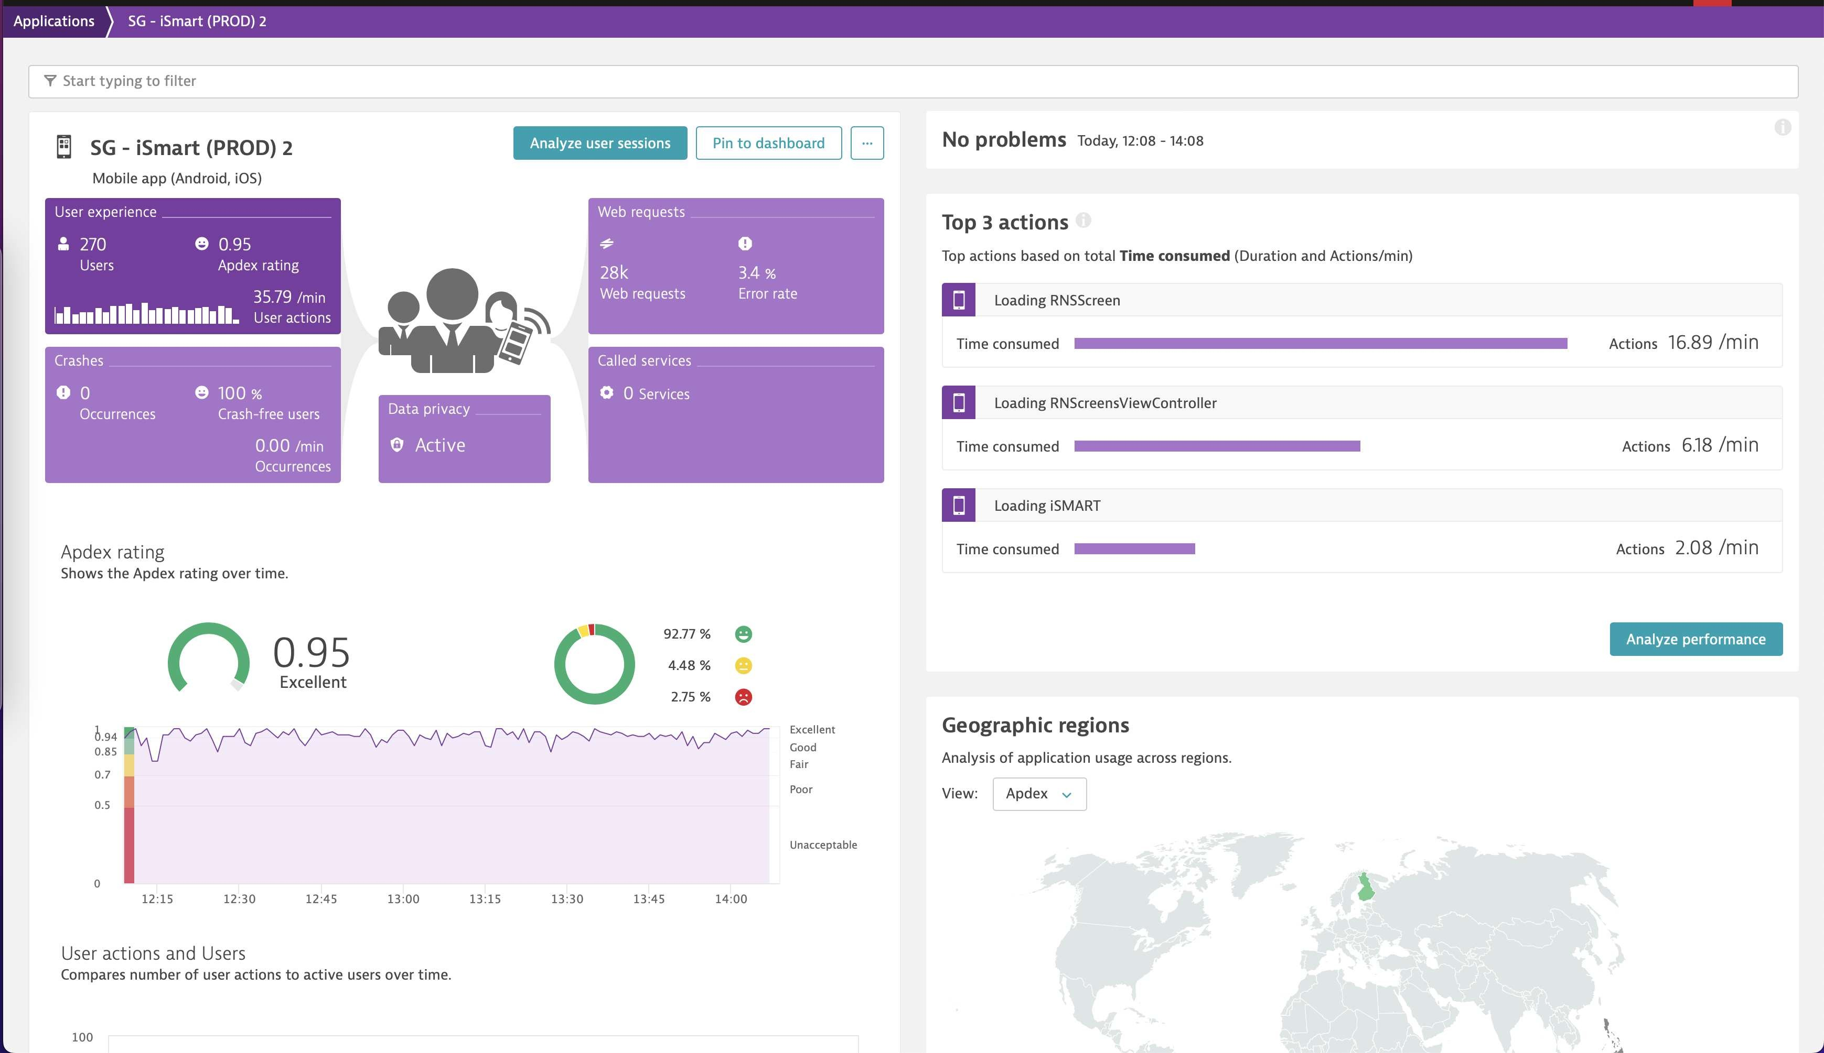
iSmart Application Performance

Slide 5
Engineering Practice

Slide 6
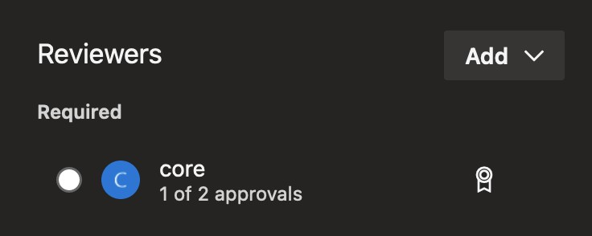
Code Review
Using Azure DevOps feature, we can set some requirement to achieve higher quality PRs. These policy are set automatically for every new PR. We require at least 2 review to merge PRs.

Slide 7
Code Review: Branching Strategies
Modified version of scaled trunk based development.
master production ready
develop temporary, reset whenever epic/* branched off from master feature/* branched off from epic/*
hotfix/* branched off master for urgent fixes outside of epic
Use merge commit (non-fast-forward), except from feature/* to epic/*.

Slide 8
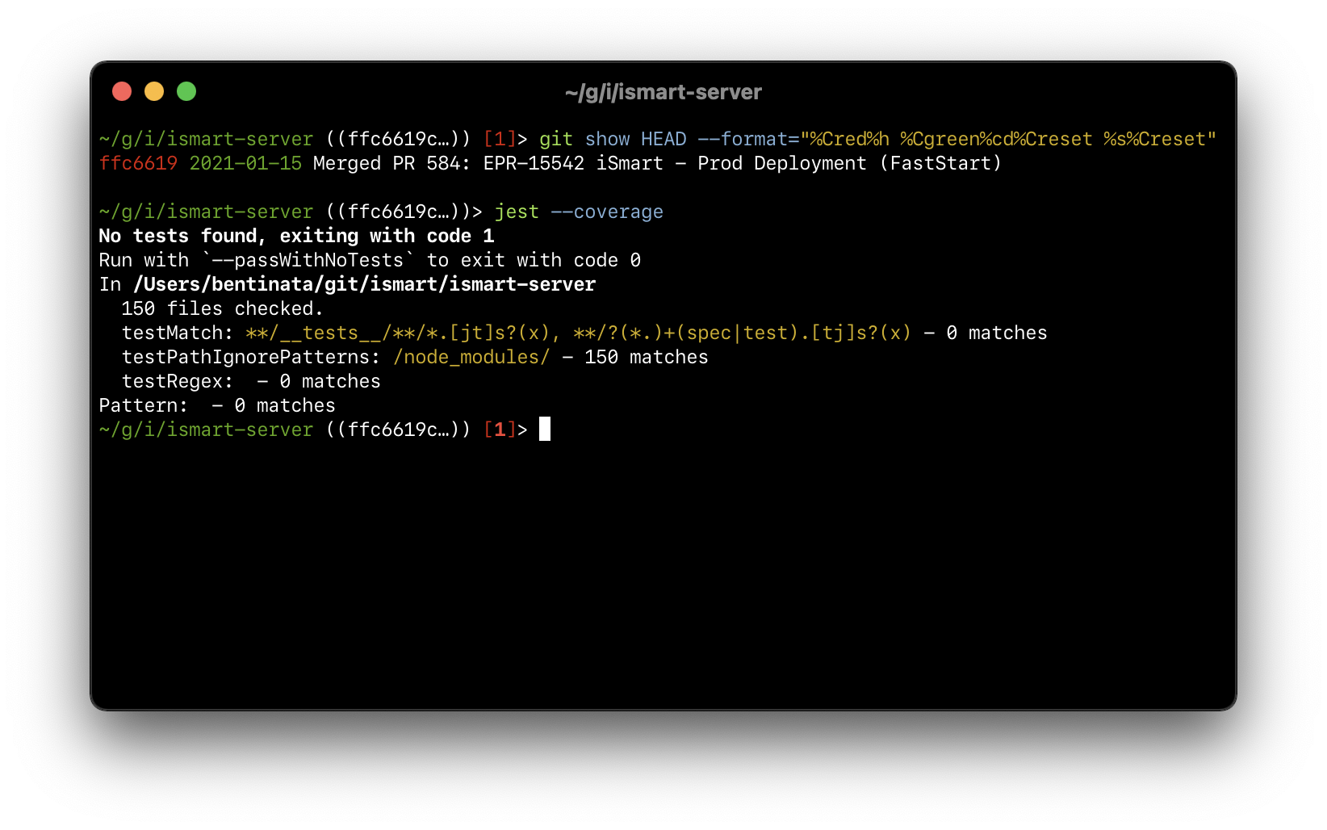
Code Coverage: Backend
From 0 coverage (Jan 2021):

Slide 9
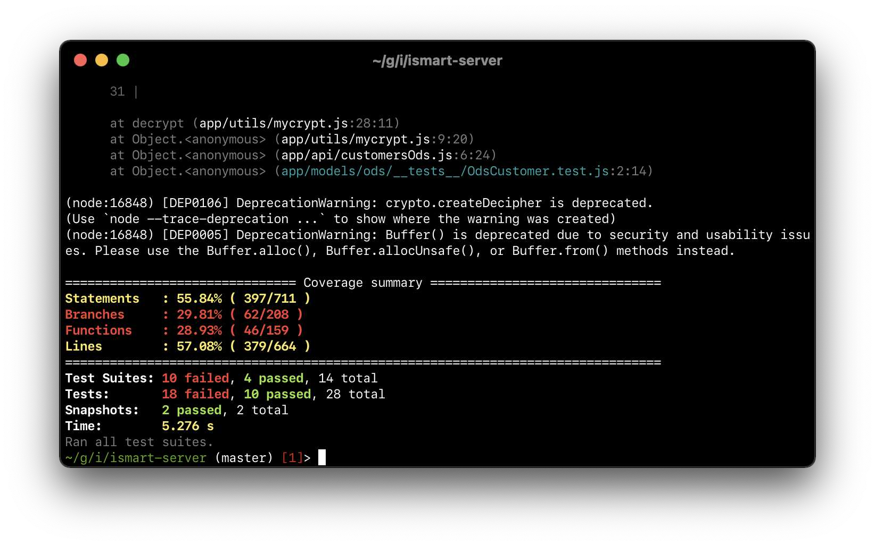
Code Coverage: Backend
To around 57% LoC covered:

Slide 10
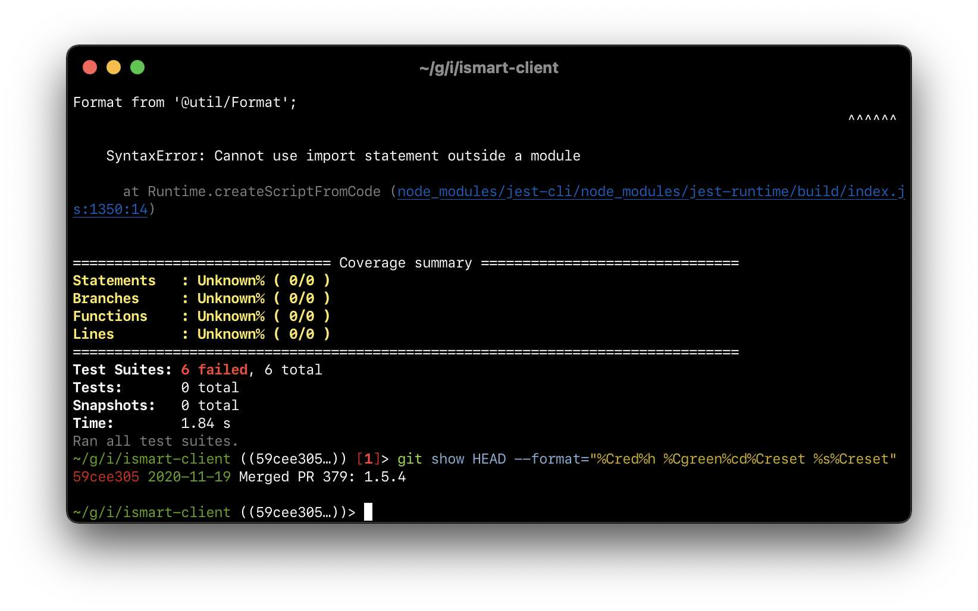
Code Coverage: Frontend
From 0 coverage (Nov 2020):

Slide 11
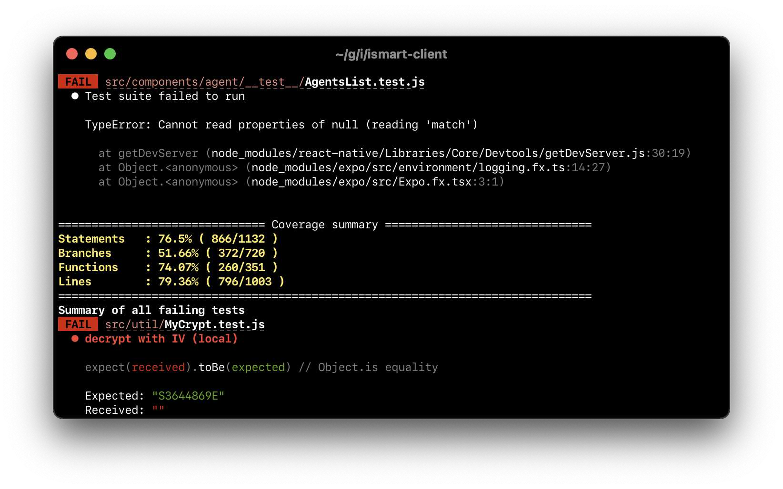
Code Coverage: Frontend
To around 79% LoC covered:

Slide 12
Code Coverage: Conclusion
Not much, but we strive for the better (80%+ covered).

Slide 13
Tech Advancements
Code coverage improvement Integration with Azure Active Directory Logging improvement npmjs.com/@aia-sg/fmt
Azure Pipelines

Slide 14
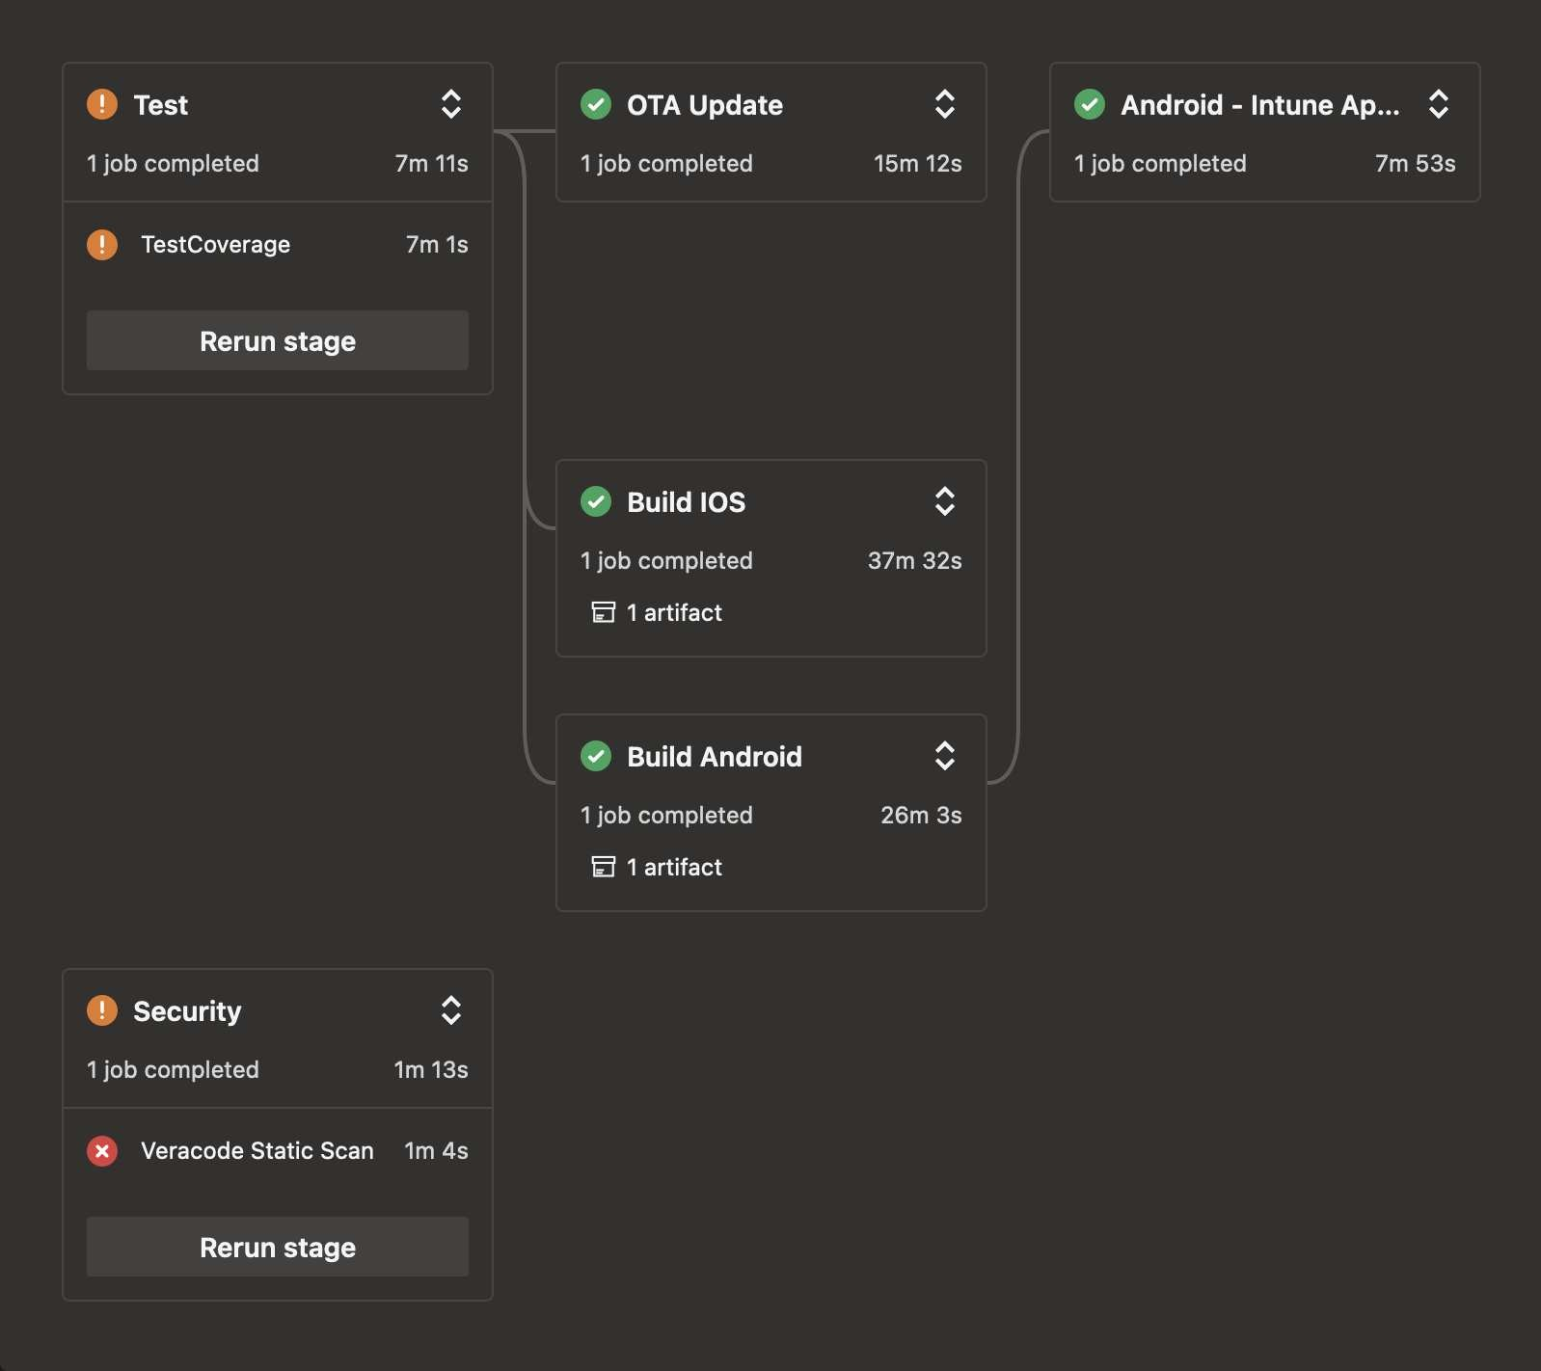
Azure Pipelines: Client Build and OTA Update

Slide 15
Team Building

Slide 16
Weekly (when not busy) sharing session
Relationship, by Ferdi Mental Health, by Fando
Starting Your Own Online Shop, by Fadli Face Detection, by Yunan
Git Branching, lodash and WSL, by Ben
Ikigai and ESLint & Prettier, by Tommy Enzyme, by Herman
YAML, by Ariq

Slide 17
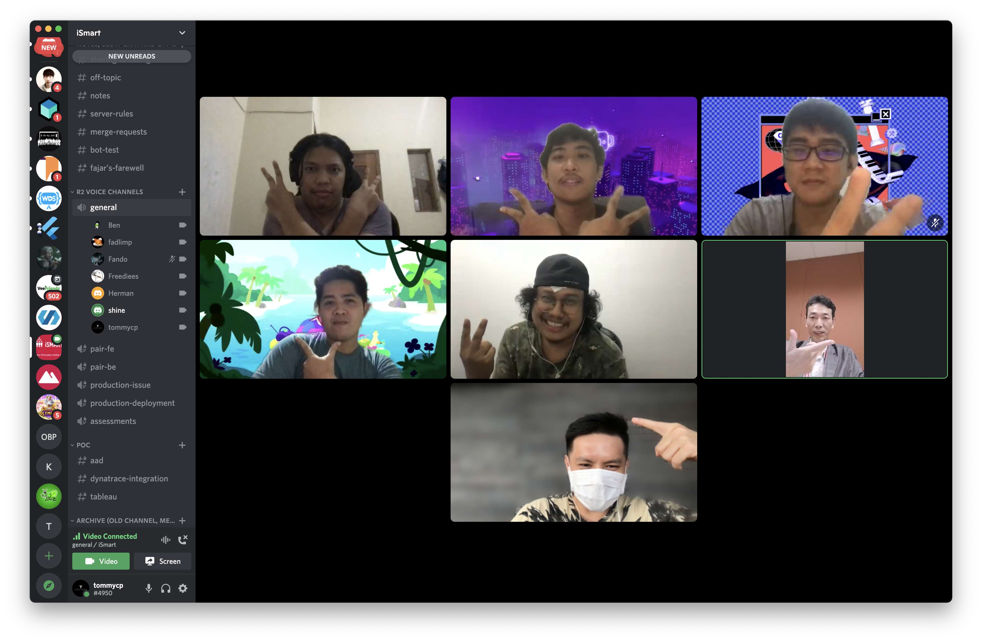
Farewell Ferdi :'(

Slide 18





But Herman, Taufiq, Caleb, Ariq, and Jul Joins!
Coffee addict
Very good cook
Lift weights
Canʼt cook
Traveler

